Slide 1
Attributing hypoxia responses of early life Menidia menidia to energetic mechanisms with Dynamic Energy Budget theory
Updates with hypoxia correction factor derived from noncompetitive inhibition of DEB processes
Correction factor developed by Roger Nisbet based on Muller et al. (2019) and implemented by Teresa Schwemmer
December 2023

Slide 2
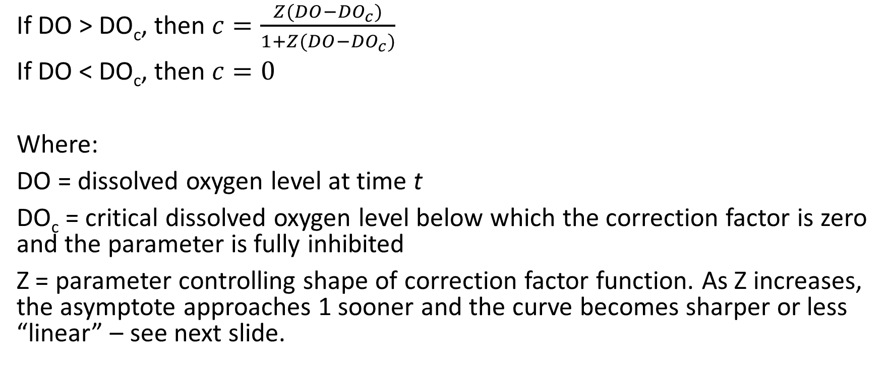
Correction factor (c) for inhibition
If DO > DO_{c}, then $c=\frac{Z(DO−{DO}_{c})}{1+Z(DO−{DO}_{c})}$
If DO < DO_{c}, then $c=0$
Where:
DO = dissolved oxygen level at time t
DO_{c} = critical dissolved oxygen level below which the correction factor is zero and the parameter is fully inhibited
Z = parameter controlling shape of correction factor function. As Z increases, the asymptote approaches 1 sooner and the curve becomes sharper or less “linear” – see next slide.

Slide 3
Inhibition and Damage
We are also interested in effects on yield coefficient of assimilates into growth (y_{VA}) but this is not a process that can be inhibited, but rather damage would apply.
“Muller et al. say that if damage production is much slower than the turnover of any of the synthesizing unit states, damage models are equivalent to analogous inhibition models. This suggests to me that it is also defensible to apply the correction factor to yield coefficients, but now interpreted as damage rather than inhibition.” –Roger’s notes on the inhibition correction factor.
For maintenance and mortality we divide the parameter by c instead of multiply it, so they increase with hypoxia.

Slide 4
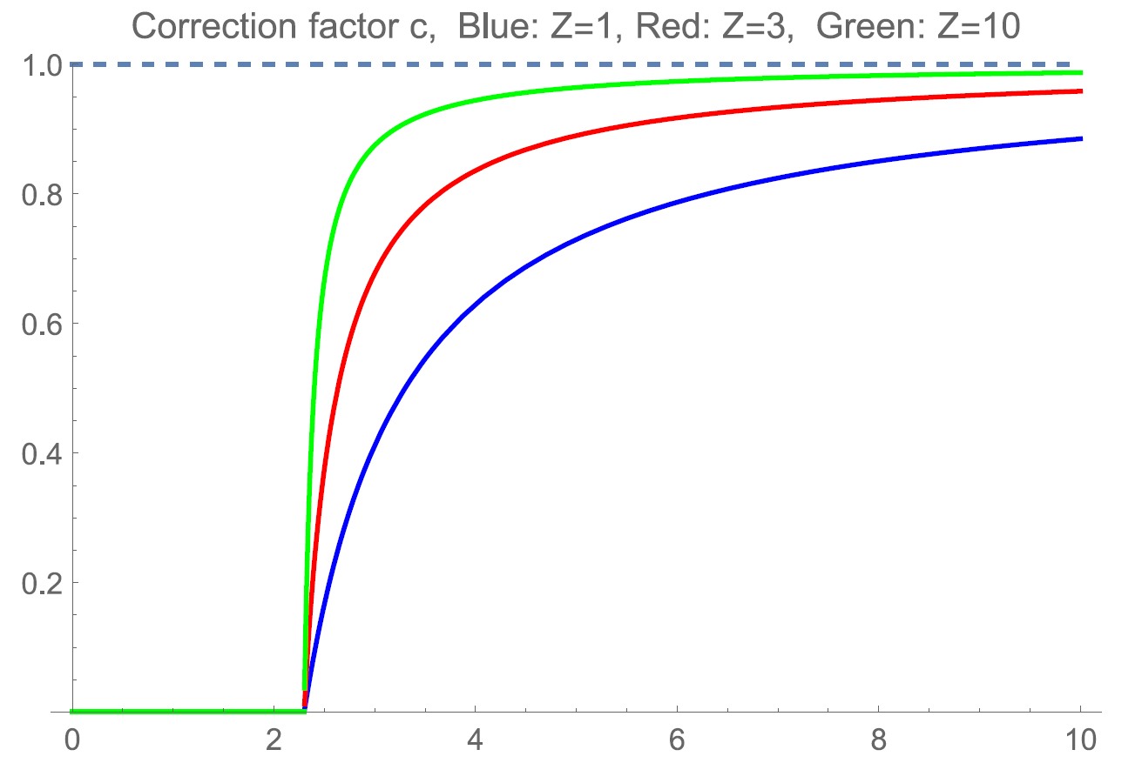
Correction factor (c) for inhibition
c
DO (mg/L)

Slide 5
Correction factor (c) for inhibition
At a given DO level, as Z → ∞, c gets closer to 1 (fully uninhibited).
As a result, the best fit is Z=100 or whatever upper limit I set, and the predicted data for all DO levels appear close to the observed datapoints for control DO level of 7.7 mg/L, black points in figures below. The correction factor is nearly 1 for all treatments, instead of getting noticeably lower as DO decreases.
This is because in the old version of the model, data were weighted by sample size which is greater for control than the low DO treatments.
Need to equally weight data for all treatment levels to get closer fit to all four DO levels instead of favoring the control DO.
This is actually something I wanted to do anyway so no treatment is favored

Slide 6
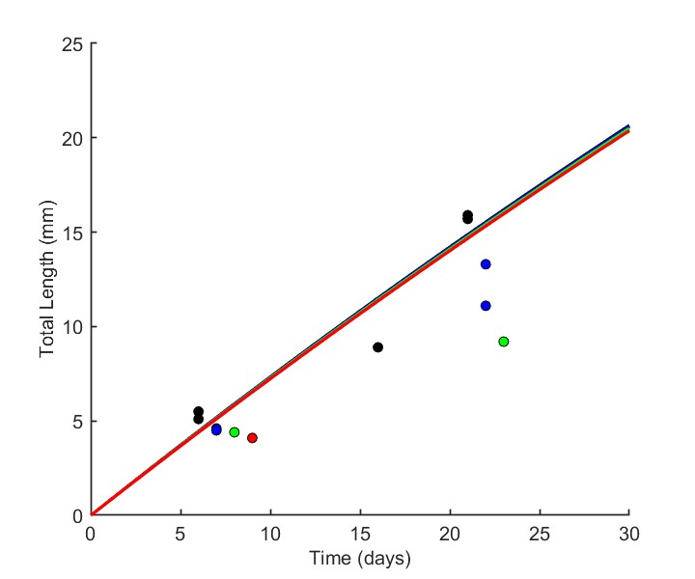
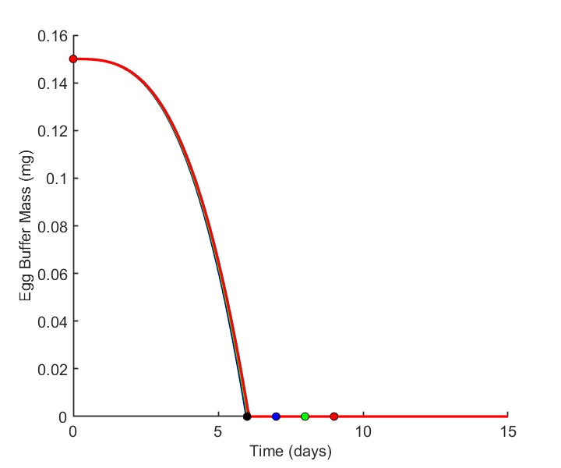
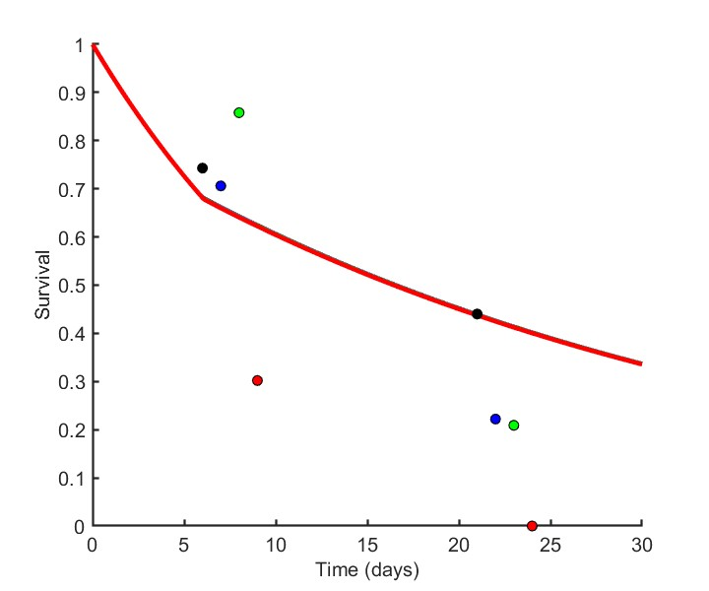
Correction factor (c) for inhibition
Figure showing fits with Z=100, c applied to assimilation
7.7 mg/L (control)
4.2 mg/L
3.1 mg/L
2.7 mg/L

Slide 7
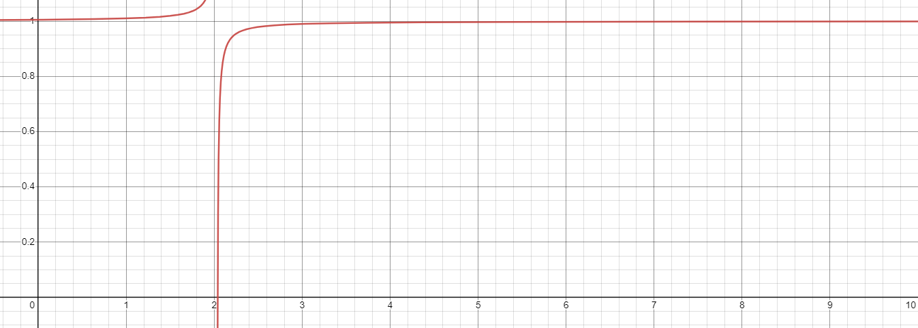
Correction factor (c) for inhibition
This is because when Z=100, c~DO looks like this:
With the low DO treatments only having VERY slightly reduced c, compared to high DO treatments (treatments marked by asterisks).
Figure showing fits with Z=100, c applied to assimilation
*
*
*
*
c
DO (mg/L)

Slide 8
New version: equally weighting data across treatments
Equal weights mean that the weights within each treatment all add up to the same number.

Slide 9
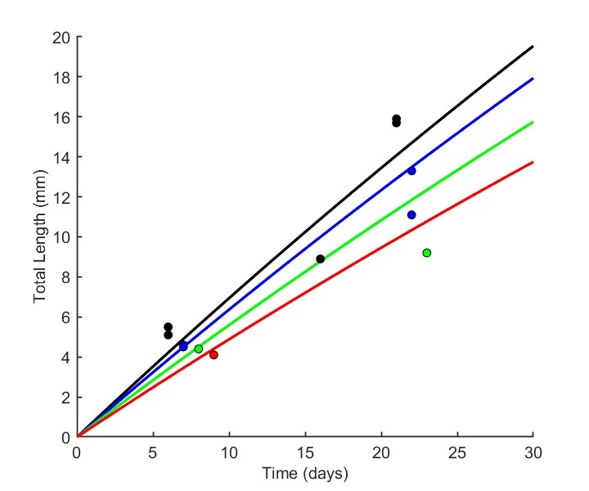
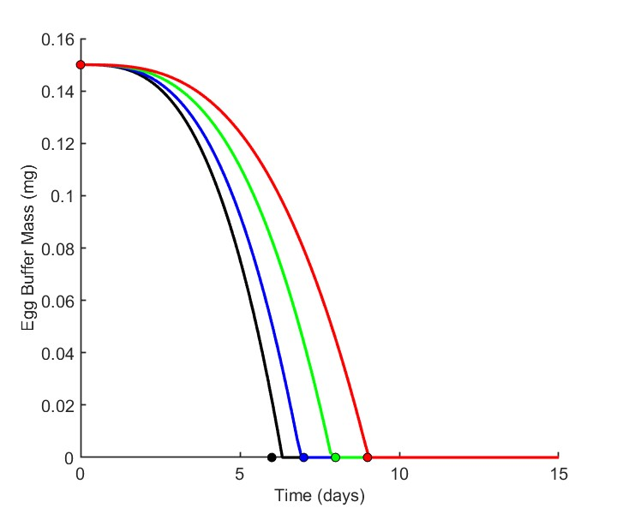
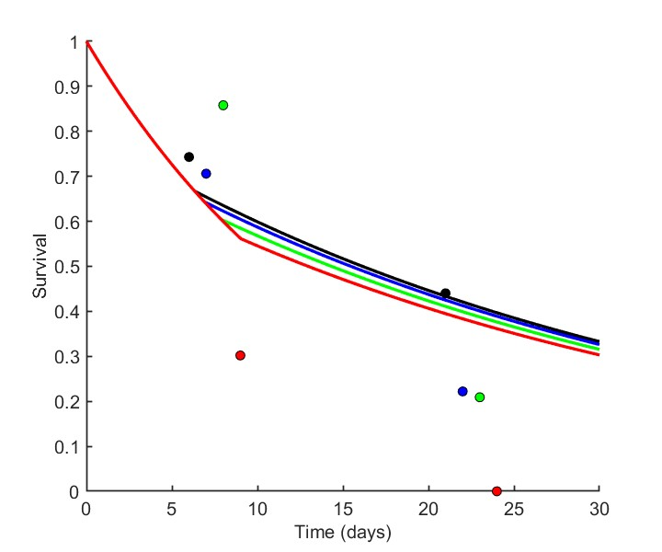
New version: equally weighting data across treatments
Now Z=3.019 (when estimating based on assimilation) which gives a closer looking fit across all four treatments.
7.7 mg/L (control)
4.2 mg/L
3.1 mg/L
2.7 mg/L

Slide 10
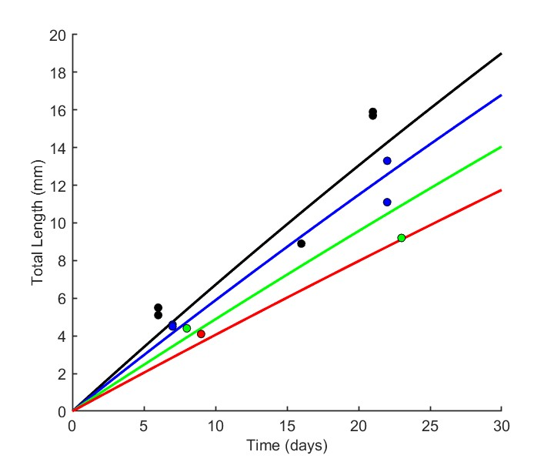
Applying inhibition to assimilation rate (Jª_{Am}) vs. yield coefficient (y_{VA})
Jª_{Am}: best Z is 3.019 (AIC=856.03)
y_{VA}: best Z is 1.818 (AIC=848.62)
7.7 mg/L (control)
4.2 mg/L
3.1 mg/L
2.7 mg/L
Most noticeable difference is applying the inhibition function to yVA produces a better fit to length data, with hypoxic treatments producing a greater effect on length than when inhibition is applied to Jª_{Am}.

Slide 11
Maintenance
Even with the equally weighted oxygen treatments, the best fit is a very large Z value (the increase in maintenance approaches zero).
Using a low Z to get a greater increase in maintenance results in slightly reduced growth that worsens with time, but no effect on time to hatching or survival rates (this is expected because of model equations).
The difference in AIC is small regardless of what Z value you use. See next slide.
The reason for this is that after 23 days-post-fertilization, there is only data for control (7.7 mg/L DO) so the slight reduction in growth brings the predicted farther away from observed, outweighing the effect of bringing the other treatments’ predicted closer to observed.
When inhibition is applied to maintenance and another parameter, a lower Z value is estimated.

Slide 12
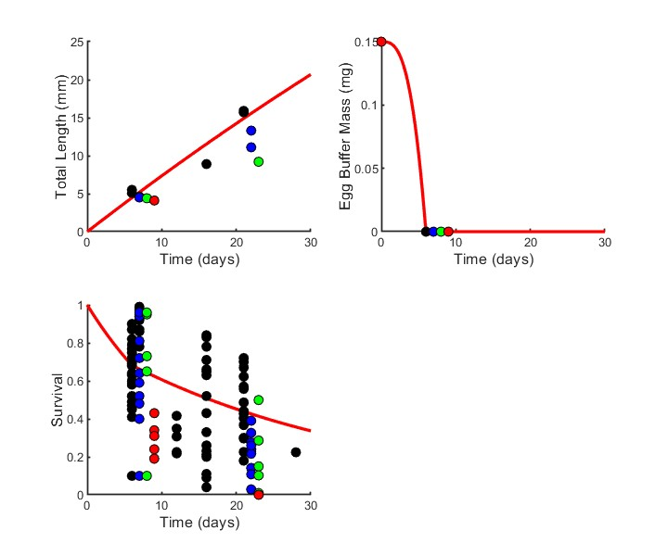
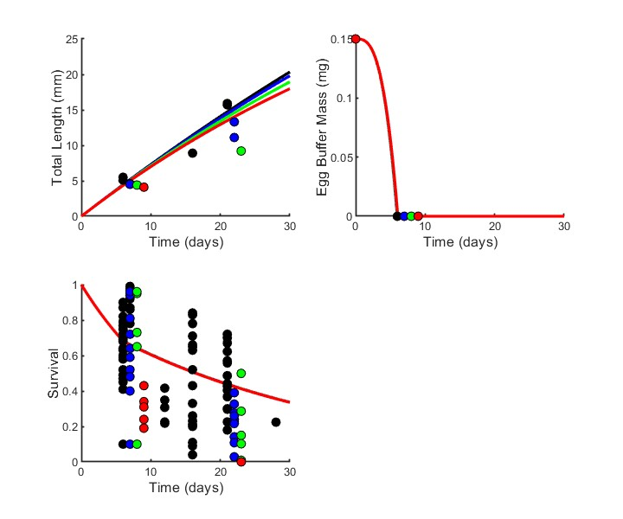
Maintenance
Z = 1
AIC = 852.7
Z = 10000
AIC = 849.18
(the other lines are hidden behind the red one, all identical)

Slide 13
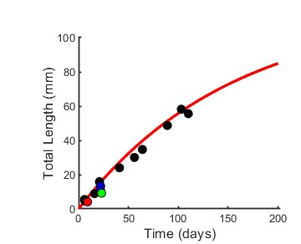
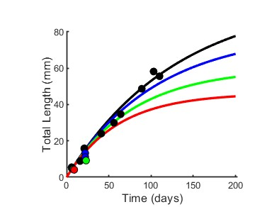
Maintenance
Here is the plot showing up to 200 days instead of 30 – if you look closely at the last few data points for length you can see why a high Z gives a slightly better fit.
Z = 1
AIC = 852.7
Z = 10000
AIC = 849.18
(the other lines are hidden behind the red one, all identical)

Slide 14
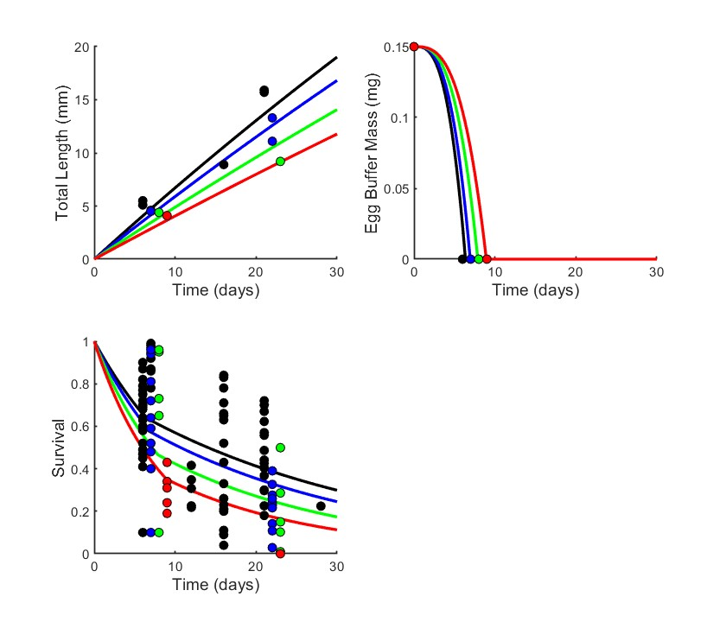
Best fit that meets the requirement that all three variables are accounted for (growth, egg buffer depletion, and survival rates) Parameters with inhibition: y_{VA}, μ_{emb}, and μ_{lar} AIC = 794.03
7.7 mg/L (control)
4.2 mg/L
3.1 mg/L
2.7 mg/L

Slide 15
Parameter(s) affected by hypoxia | Estimated Z [95% CI] | AICc | ΔAICc | Akaike weight
Jª_{Am} | 3.019 [2.512-3.612] | 856.06 | 62.03 | 2.5e-14
y_{VA} | 1.818 [1.601-2.342] | 848.65 | 54.62 | 1.0e-12
Jª_{Am} + J^{v}_{M} | 3.105 [2.651-3.726] | 855.00 | 60.97 | 4.2e-14
y_{VA} + J^{v}_{M} | 1.985 [1.688-2.774] | 850.64 | 56.61 | 3.7e-13
Jª_{Am} + μ_{emb} | 2.804 [1.605-3.287] | 823.24 | 29.21 | 3.3e-7
y_{VA} + μ_{emb} | 1.801 [1.570-2.167] | 808.12 | 14.09 | 6.3e-4
Jª_{Am} + μ­_{lar} | 2.930 [2.165-3.428] | 838.17 | 44.14 | 1.9e-10
y_{VA} + μ_{lar} | 1.767 [1.536-2.111] | 821.30 | 27.27 | 8.7e-7
Jª_{Am} + μ_{emb} + μ_{lar} | 2.819 [1.920-3.286] | 810.21 | 16.18 | 2.2e-4
y_{VA} + μ_{emb} + μ_{lar} | 1.827 [1.620-2.269] | 794.03 | 0 | 0.72
Jª_{Am} + J^{v}_{M} + μ_{emb} + μ_{lar} | 2.913 [2.288, 3.387] | 809.96 | 15.93 | 2.5e-4
y_{VA} + J^{v}_{M} + μ_{emb} + μ_{lar} | 1.981 [1.700, 2.456] | 795.97 | 1.94 | 0.27
The model with y_{VA}, μ_{emb}, and μ_{lar} is 0.72/0.27 = 2.667 times as probable as the one that additionally has J^{v}_{M}.
The model with y_{VA}, μ_{emb}, and μ_{lar} is 0.72/0.00022 = 3272.72

Slide 16
Intro is long. A lto of it is critical for understanding the model, move a lot of the second half to methods. Physiological background, expand section that introduces ‘relating abstract deb processes to physiology’.
For a theory or modeling journal don t need to stick to typical structure. Can have whatever sections you like. Maybe call methods section something different. Methods section can include the WHY as well as the WHAT we did.
Diel fluctuations intro point may not be needed for intro but rather discussion, because time scale doesn’t work with DEB. Roger thinks the interaction stuff is important tho. There are other models that specifically look at extreme events which would be good to look at fluctuations.
DEB model should be mentioned before stuff about connecting to population changes (which we don’t even look at).
Or maybe leave it as is pretty much but pick up in discussion that we don’t have the full life data on hypoxia in adults to get population dynamics.
Rewrite paragraph 5 using Jager recent papers about merits of simplification in investigating stress: a lot of the work by Kooijman has been about unified approach across all species, but for modeling stress (control vs treatments) – what matters is having a good fit to control. Std DEB doesn’t necessarly do good characterization of the life stages we are interested in, but DEBkiss gives access to sharper ability to characterize ELS. We are mostly not concerned with complete description of life cycle. We are concerned with contrasting normoxia and hypoxia responses.
Also we don’t describe the standard DEB model before mentioning it.
Roger will rewrite
6th paragraph “road map” – all the necessary background is covered up to this point. End intro here, everything after this moves to part of next section.
Section 2.2 Relating abstract DEBkiss processes to physiology.
Do we want subsection on linking inhibition and damage to hypoxia?
Mortality
Data and fitting: hard to understand?
Remove LVf parameter

